Slide 1
Prototype Design of
Remote-Controlled Model Vehicle via Wireless Communication
Glasgow College, UESTC
Student: XXXXXXXX
GUID: xxxxxxxxxxxxx
UESTC ID: xxxxxxxx

Slide 2
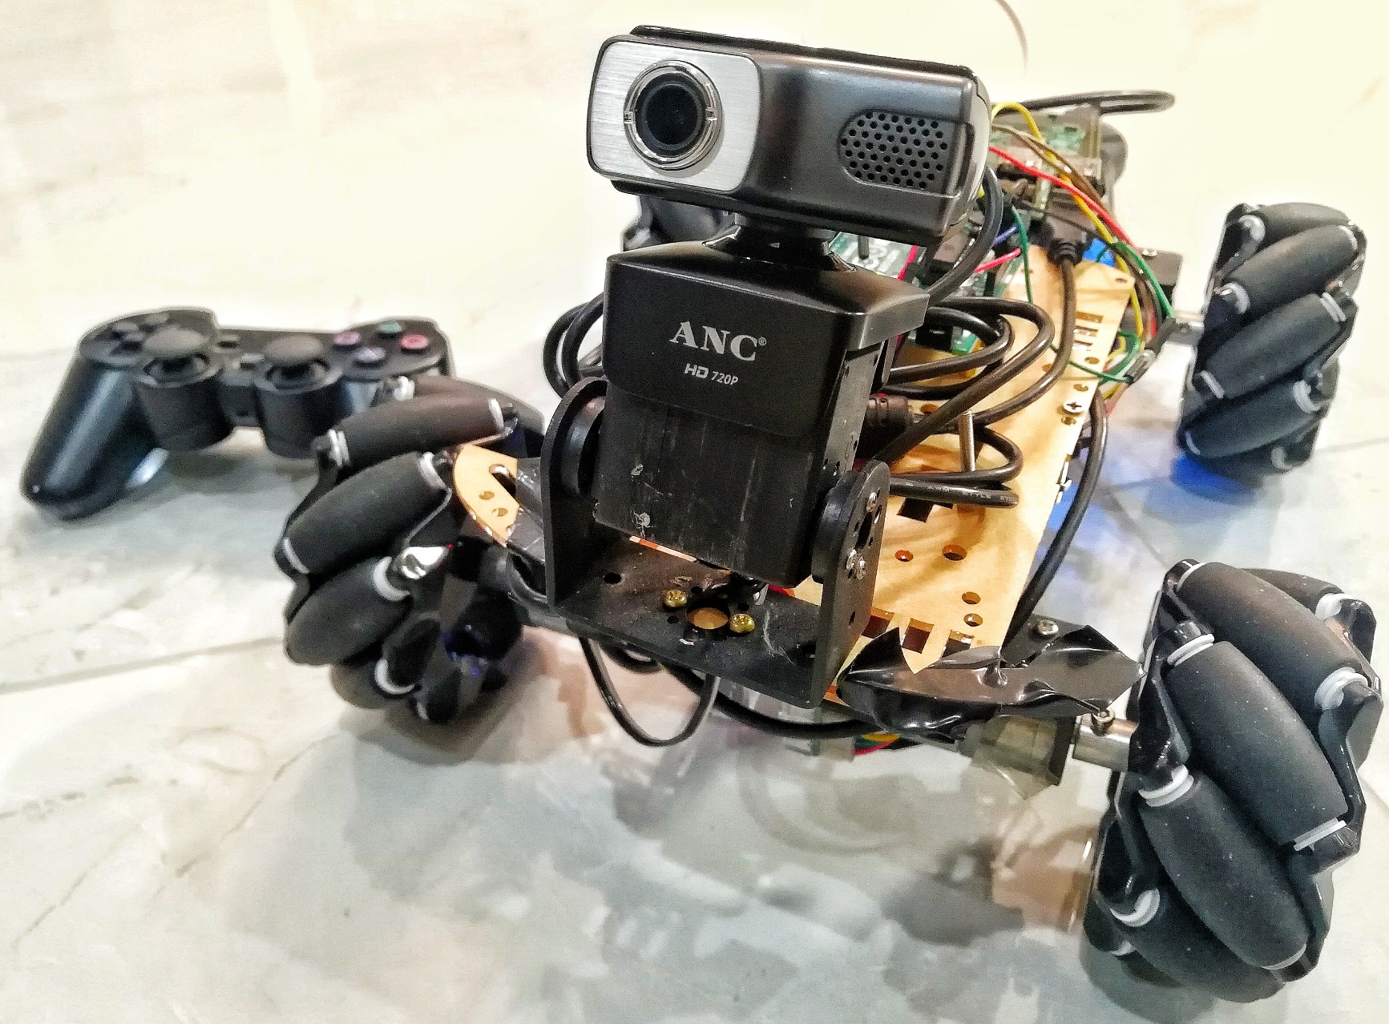
Nick’s Explorer

Slide 3

CONTENTS
1
Introduction
2
Technical Details
3
Application
4
Conclusion

Slide 4
CONTENTS
1
Introduction
2
Technical Details
3
Application
4
Conclusion

Slide 5
01
Glasgow College, UESTC
Nick’s Explorer
Introduction

Slide 6



01 Introduction
Contents
Nick’s Explorer
Introduction
1.1 Background
1.2 Features
1.3 System Architecture

Slide 7
01 Introduction
1.1 Background
1
Technology & science development
2
Accuracy, Cost-effective, High efficiency
3
Mechanization

Slide 8
01 Introduction
Contents
Nick’s Explorer
Introduction
1.1 Background
1.2 Features
1.3 System Architecture

Slide 9

01 Introduction
Video Transmission
1.2 Features
Remote control via
PS2 gamepad
Omnidirectional Movement

Slide 10
01 Introduction
Contents
Nick’s Explorer
Introduction
1.1 Background
1.2 Features
1.3 System Architecture

Slide 11
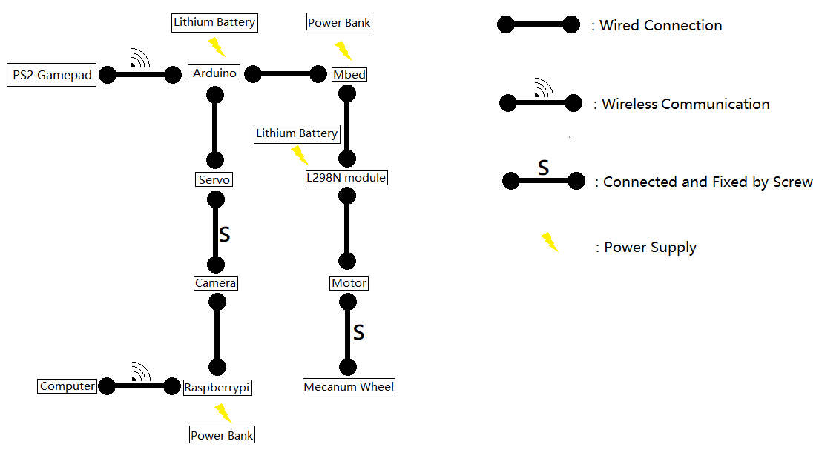
01 Introduction
1.3 System Architecture

Slide 12
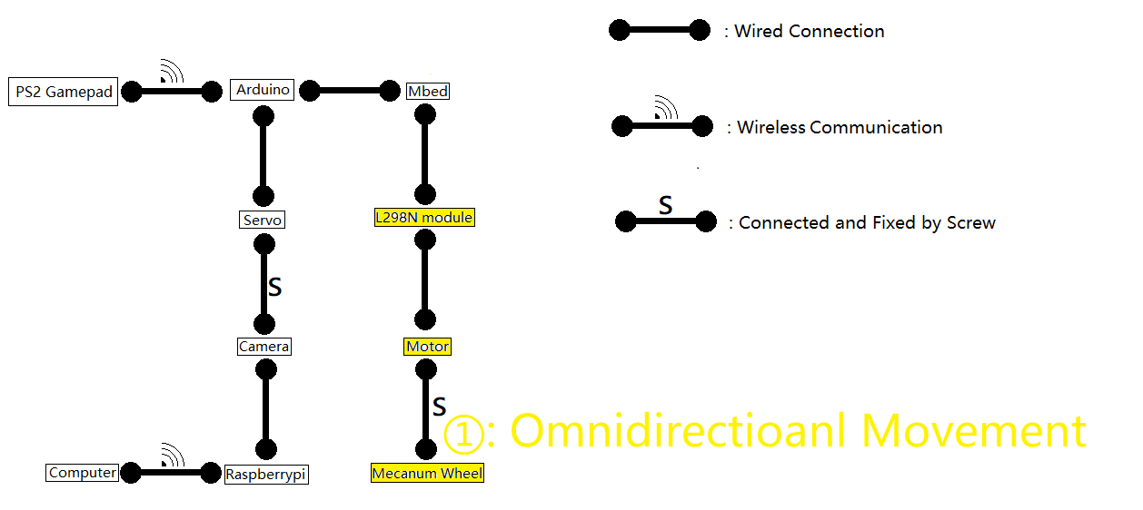
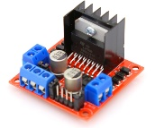
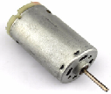
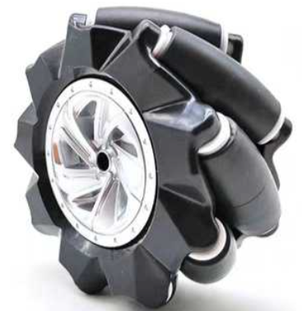
01 Introduction
1.3 System Architecture
Notes:
Key component

Slide 13
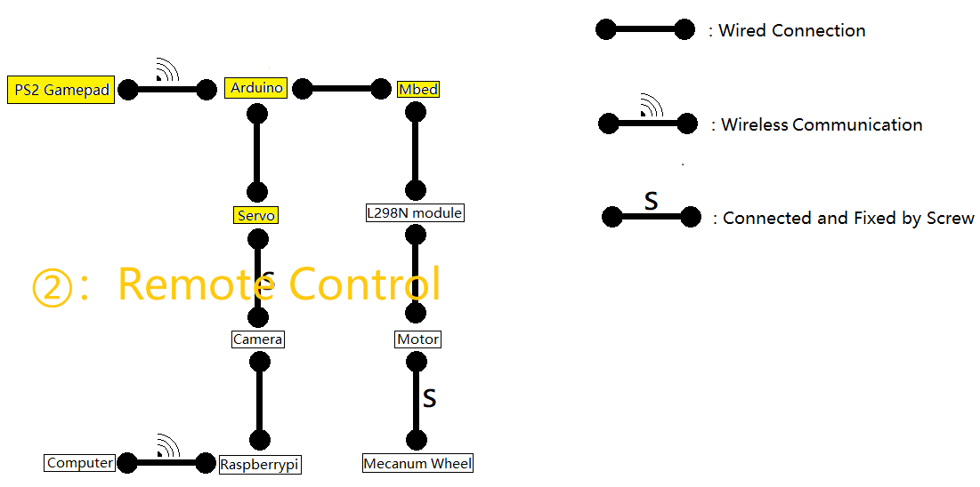
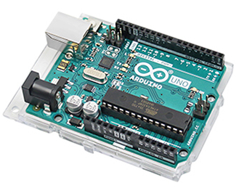
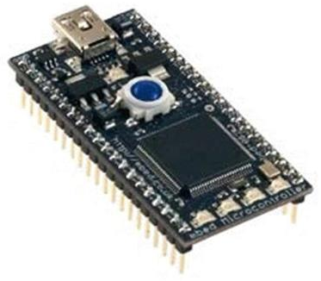
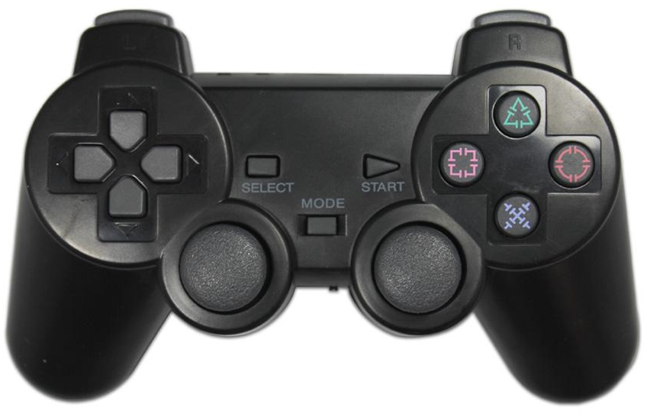
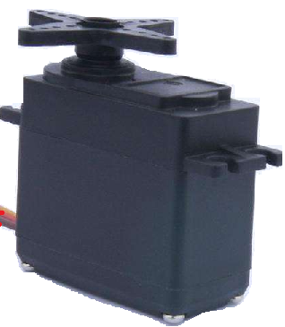
01 Introduction
1.3 System Architecture

Slide 14
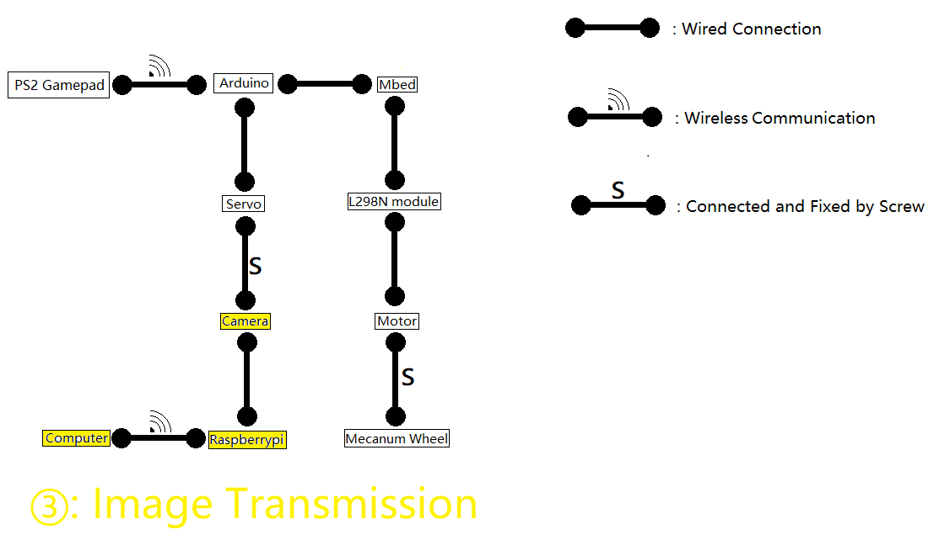
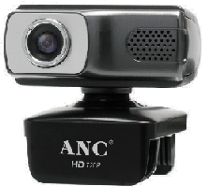

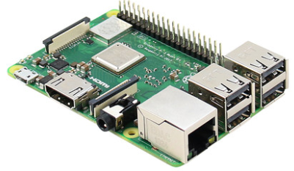
01 Introduction
1.3 System Architecture

Slide 15
01 Introduction
Contents
Nick’s Explorer
Introduction
1.1 Background
1.2 Features
1.3 System Architecture

Slide 16
CONTENTS
1
Introduction
2
Technical Details
3
Application
4
Conclusion

Slide 17
CONTENTS
1
Introduction
2
Technical Details
3
Application
4
Conclusion

Slide 18
02
Glasgow College, UESTC
Nick’s Explorer
Technical Details

Slide 19
02 Technical Details
Contents
Nick’s Explorer
Technical Details
2.1 Omnidirectional Movement
2.2 Remote Control
2.3 Image Transmission

Slide 20

02 Technical Details
2.1 Omnidirectional Movement
Mbed
L298N modules
Mecanum Wheel

Slide 21

02 Technical Details
2.1 Omnidirectional Movement
· Controlled directly by Arduino
· Output to L298N modules
· Omnidirectional movements program

Slide 22
02 Technical Details
2.1 Omnidirectional Movement
Mbed
L298N modules
Mecanum Wheel

Slide 23
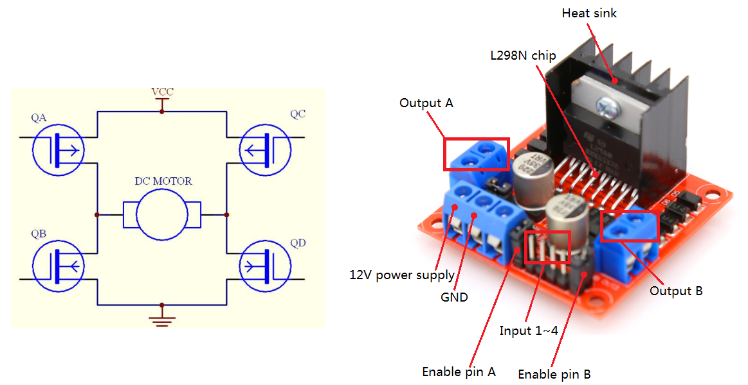
02 Technical Details
2.1 Omnidirectional Movement
H bridge
Interface diagram
Notes:
H 桥，QA QD 导通 顺时针转动；接口示意图，需要12V 供电，以及PWM 输入

Slide 24
02 Technical Details
2.1 Omnidirectional Movement
Mbed
L298N modules
Mecanum Wheel

Slide 25
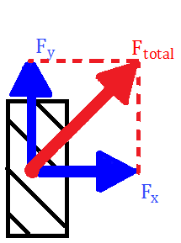
02 Technical Details
2.1 Omnidirectional Movement
Planform
Notes:
Subjected to ground，rotating forward. Planform. Rotate backwards, arrow lower left

Slide 26
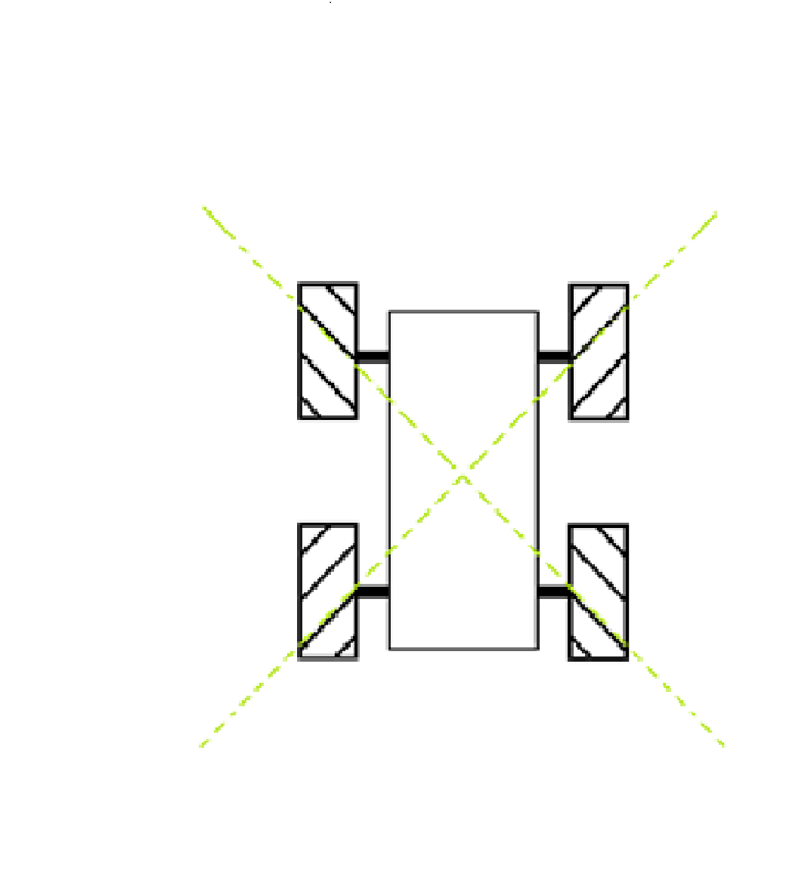
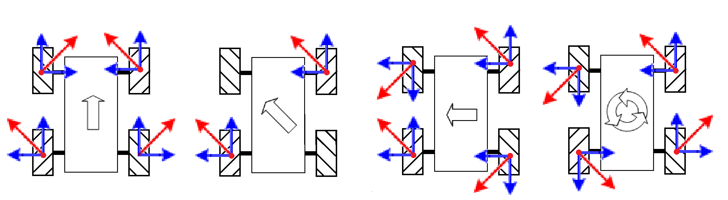
02 Technical Details
2.1 Omnidirectional Movement
‘X’ type arrangement
Notes:
Subjected to ground，rotating forward，bird view

Slide 27
02 Technical Details
Contents
Nick’s Explorer
Technical Details
2.1 Omnidirectional Movement
2.2 Remote Control
2.3 Image Transmission

Slide 28
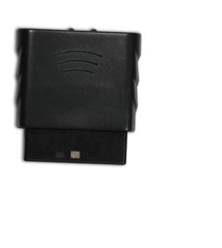
02 Technical Details
2.2 Remote Control
2.4G
PS2 Gamepad
Receiver
Arduino
Notes:
2.4G wireless communication protocol. Receiver wired connection with Arduino

Slide 29
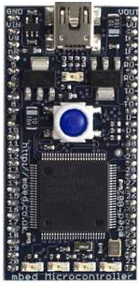
02 Technical Details
2.2 Remote Control
PWM signal
4-bit digital signal
Servo Motor
Arduino
Mbed

Slide 30
02 Technical Details
2.2 Remote Control
Angular position
PWM signal
duty cycle
30° | 20%
150° | 100%
Servo Motor
Notes:
最大和最小值

Slide 31
02 Technical Details
2.2 Remote Control
30° | 20%
150° | 100%

Slide 32
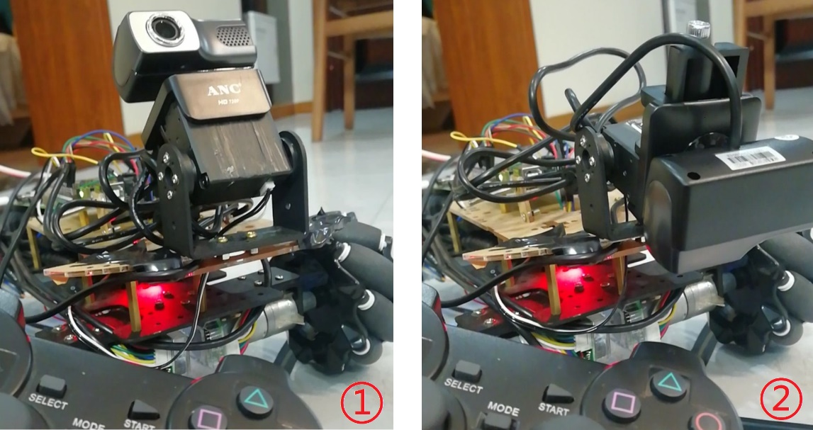
02 Technical Details
2.2 Remote Control
30° | 20%
150° | 100%

Slide 33
02 Technical Details
2.2 Remote Control
30° | 20%
150° | 100%

Slide 34
02 Technical Details
2.2 Remote Control
PWM signal
4-bit digital signal
Servo Motor
Arduino
Mbed

Slide 35

02 Technical Details
2.2 Remote Control
4-bit digital signal
H/L
H/L
H/L
H/L
Mbed program
1/0
1/0
1/0
1/0
Notes:
H/L voltages to represent 1/0

Slide 36
02 Technical Details
2.2 Remote Control
Example：
H
L
L
L

Slide 37
02 Technical Details
2.2 Remote Control
L L H L
INSTRUCTION 0
INSTRUCTION 1
INSTRUCTION 2
INSTRUCTION 3
INSTRUCTION 4
INSTRUCTION 5
INSTRUCTION 6
INSTRUCTION 7
INSTRUCTION 8
INSTRUCTION 9
INSTRUCTION 10
INSTRUCTION 0
INSTRUCTION 1
INSTRUCTION 2
INSTRUCTION 3
INSTRUCTION 4
INSTRUCTION 5
INSTRUCTION 6
INSTRUCTION 7
INSTRUCTION 8
INSTRUCTION 9
INSTRUCTION 10

Slide 38
02 Technical Details
2.2 Remote Control
L L H L
INSTRUCTION 0
INSTRUCTION 1
INSTRUCTION 2
INSTRUCTION 3
INSTRUCTION 4
INSTRUCTION 5
INSTRUCTION 6
INSTRUCTION 7
INSTRUCTION 8
INSTRUCTION 9
INSTRUCTION 10
INSTRUCTION 0
INSTRUCTION 1
INSTRUCTION 2
INSTRUCTION 3
INSTRUCTION 4
INSTRUCTION 5
INSTRUCTION 6
INSTRUCTION 7
INSTRUCTION 8
INSTRUCTION 9
INSTRUCTION 10
0 0 1 0
Notes:
Voltages converted to corresponding instruction

Slide 39
02 Technical Details
2.2 Remote Control
L L H L
INSTRUCTION 0
INSTRUCTION 1
INSTRUCTION 2
INSTRUCTION 3
INSTRUCTION 4
INSTRUCTION 5
INSTRUCTION 6
INSTRUCTION 7
INSTRUCTION 8
INSTRUCTION 9
INSTRUCTION 10
INSTRUCTION 0
INSTRUCTION 1
INSTRUCTION 2
INSTRUCTION 3
INSTRUCTION 4
INSTRUCTION 5
INSTRUCTION 6
INSTRUCTION 7
INSTRUCTION 8
INSTRUCTION 9
INSTRUCTION 10
0 0 1 0
Notes:
Voltages converted to corresponding instruction

Slide 40

02 Technical Details
2.2 Remote Control
INSTRUCTION 0
INSTRUCTION 1
INSTRUCTION 2
INSTRUCTION 3
INSTRUCTION 4
INSTRUCTION 5
INSTRUCTION 6
INSTRUCTION 7
INSTRUCTION 8
INSTRUCTION 9
INSTRUCTION 10
INSTRUCTION 2
0 0 1 0
Notes:
Instructions controls movement

Slide 41
02 Technical Details
2.2 Remote Control
PWM signal
4-bit digital signal
Servo Motor
Arduino
Mbed

Slide 42
02 Technical Details
2.2 Remote Control
2.4G
PS2 Gamepad
Receiver
Arduino
Notes:
2.4G wireless communication protocol. Receiver wired connection with Arduino

Slide 43
02 Technical Details
Contents
Nick’s Explorer
Technical Details
2.1 Omnidirectional Movement
2.2 Remote Control
2.3 Image Transmission

Slide 44


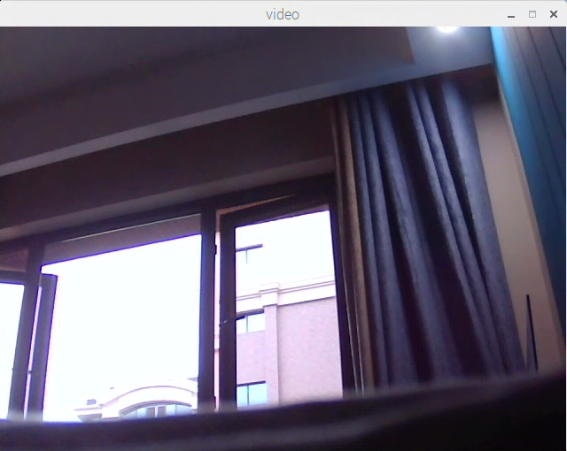
02 Technical Details
2.3 Image Transmission

Slide 45
02 Technical Details
2.3 Image Transmission

Slide 46
02 Technical Details
2.3 Image Transmission

Slide 47

02 Technical Details
2.3 Image Transmission

Slide 48
02 Technical Details
2.3 Image Transmission

Slide 49
02 Technical Details
2.3 Image Transmission
Maximum range？

Slide 50

02 Technical Details
2.3 Image Transmission

Slide 51
02 Technical Details
2.3 Image Transmission

Slide 52
02 Technical Details
2.3 Image Transmission
Maximum range？

Slide 53
02 Technical Details
2.3 Image Transmission
Maximum range？

Slide 54
02 Technical Details
Contents
Nick’s Explorer
Technical Details
2.1 Omnidirectional Movement
2.2 Remote Control
2.3 Image Transmission

Slide 55
CONTENTS
1
Introduction
2
Technical Details
3
Application
4
Conclusion

Slide 56
CONTENTS
1
Introduction
2
Technical Details
3
Application
4
Conclusion

Slide 57
03
Glasgow College, UESTC
Nick’s Explorer
Application

Slide 58
03 Application
Contents
Nick’s Explorer
Application
3.1 Security Patrol
3.2 Reconnaissance
3.3 Search and Rescue

Slide 59
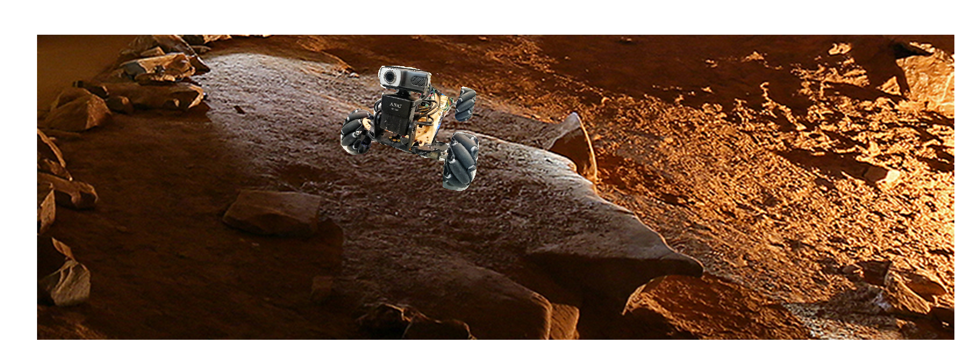
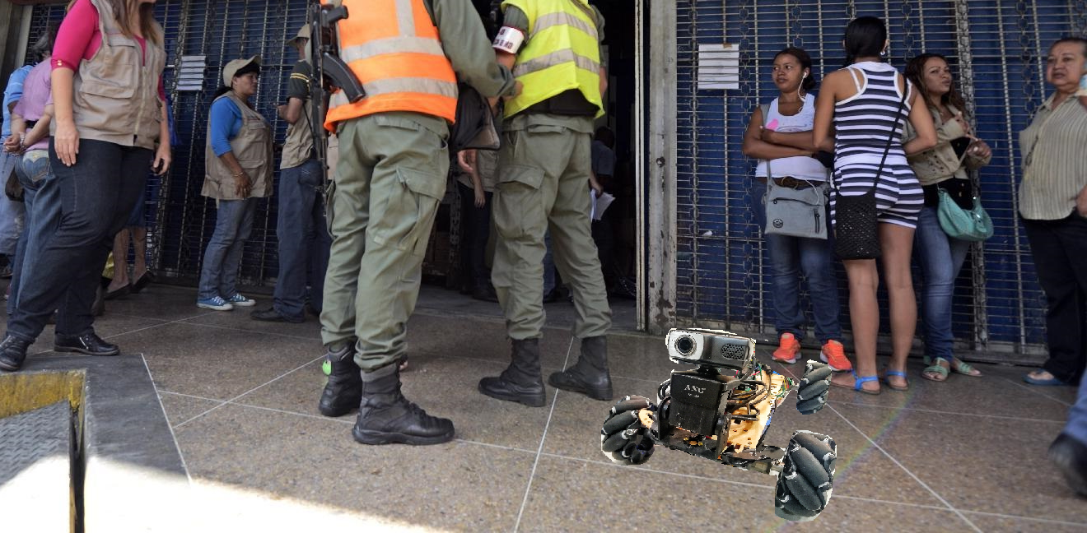
03 Application
3.1 Security Patrol
3.1 Security Patrol
3.2 Reconnaissance
3.3 Search and Rescue

Slide 60
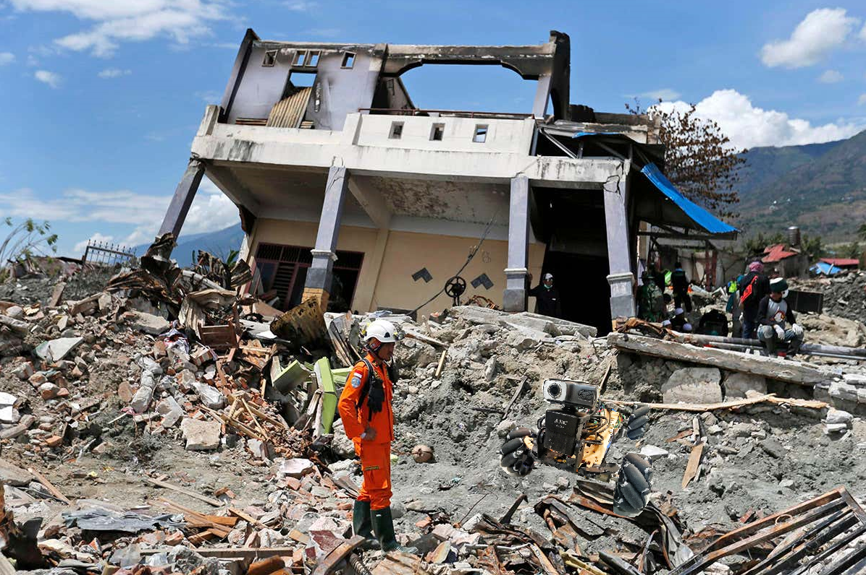
03 Application
3.2 Reconnaissance
3.1 Security Patrol
3.2 Reconnaissance
3.3 Search and Rescue

Slide 61
03 Application
3.3 Search and Rescue
3.1 Security Patrol
3.2 Reconnaissance
3.3 Search and Rescue

Slide 62
03 Application
Contents
Nick’s Explorer
Application
3.1 Security Patrol
3.2 Reconnaissance
3.3 Search and Rescue

Slide 63
CONTENTS
1
Introduction
2
Technical Details
3
Application
4
Conclusion

Slide 64
CONTENTS
1
Introduction
2
Technical Details
3
Application
4
Conclusion

Slide 65
04
Glasgow College, UESTC
Nick’s Explorer
Conclusion

Slide 66


04 Conclusion
Contents
Nick’s Explorer
Conclusion
4.1 Project summary
4.2 Suggestions

Slide 67
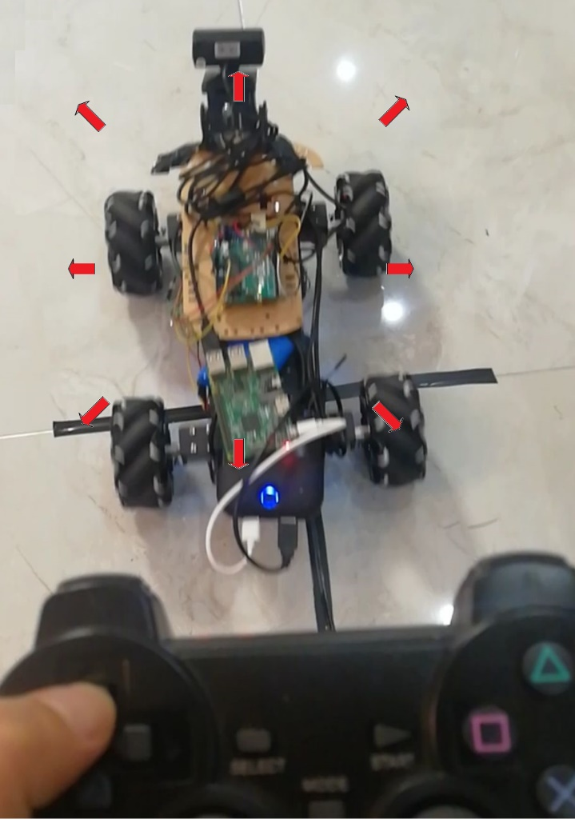
04 Conclusion
4.1 Project Summary
Omnidirectional Movement
Remote Control
Image Transmission

Slide 68
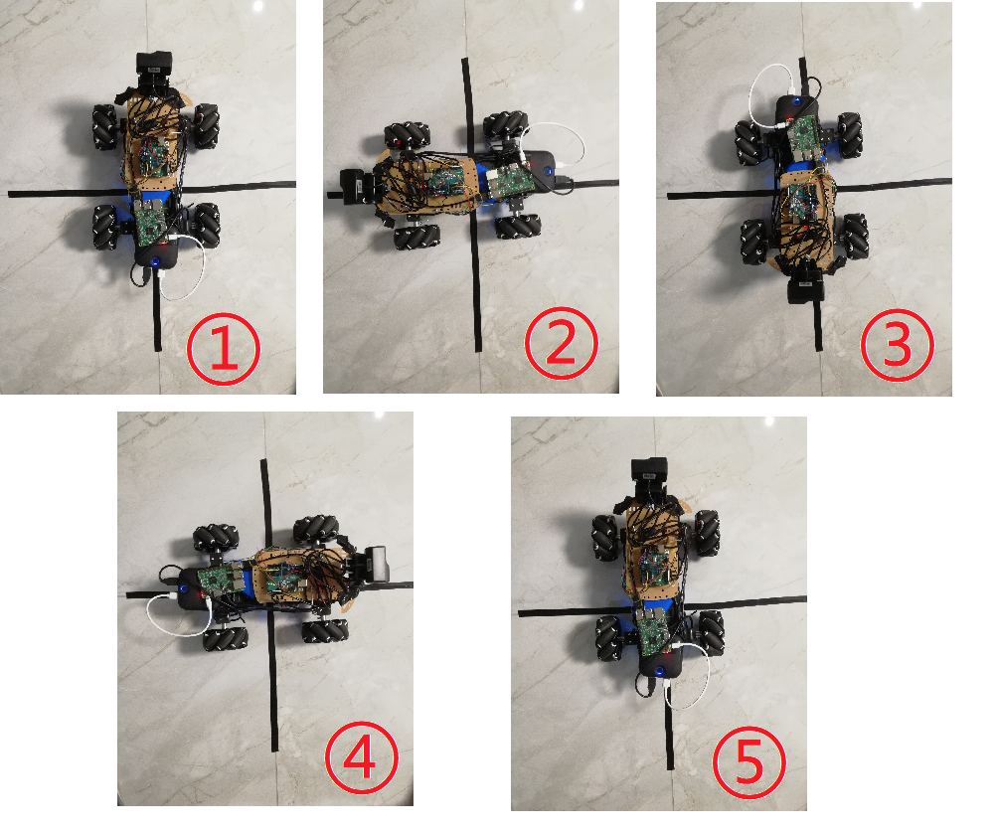
04 Conclusion
4.1 Project Summary
Omnidirectional Movement
Remote Control
Image Transmission

Slide 69
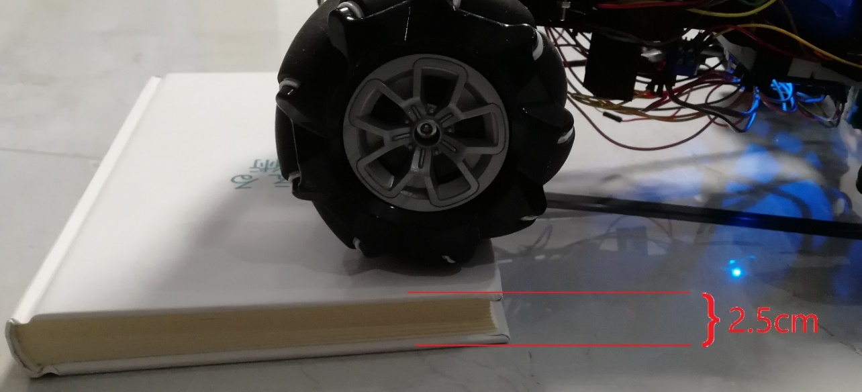
04 Conclusion
4.1 Project Summary
Omnidirectional Movement
Remote Control
Image Transmission

Slide 70
04 Conclusion
4.1 Project Summary
Omnidirectional Movement
Remote Control
Image Transmission

Slide 71
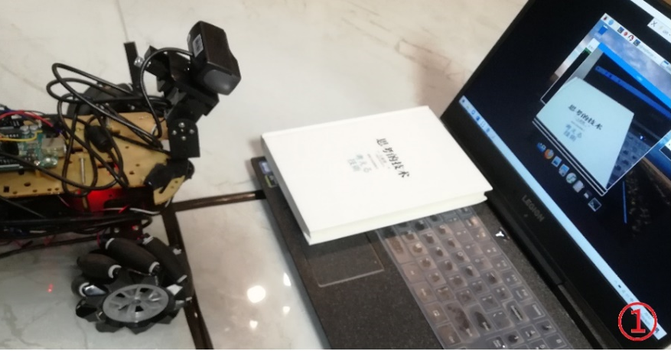
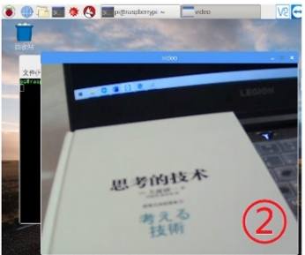
04 Conclusion
4.1 Project Summary
Omnidirectional Movement
Remote Control
Image Transmission

Slide 72
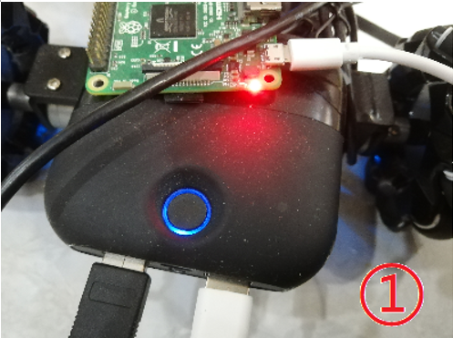

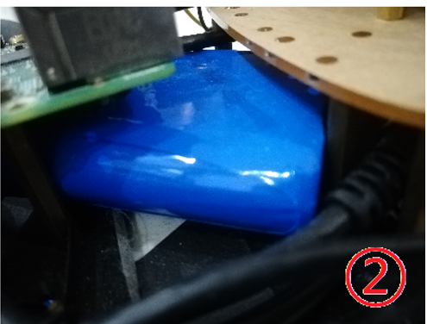
04 Conclusion
4.1 Project Summary
Omnidirectional Movement
Remote Control
Image Transmission

Slide 73

04 Conclusion
4.1 Project Summary
Omnidirectional Movement
Remote Control
Image Transmission

Slide 74
04 Conclusion
4.1 Project Summary
Omnidirectional Movement
Remote Control
Image Transmission

Slide 75
04 Conclusion
4.1 Project Summary
Omnidirectional Movement
Remote Control
Image Transmission

Slide 76
04 Conclusion
Contents
Nick’s Explorer
Conclusion
4.1 Project summary
4.2 Suggestions

Slide 77

04 Conclusion
4.2 Suggestions
Face recognition

Slide 78
04 Conclusion
4.2 Suggestions
Face recognition
Better hardware components

Slide 79
04 Conclusion
4.2 Suggestions
Face recognition
Better hardware components
Vehicle shell

Slide 80
04 Conclusion
Contents
Nick’s Explorer
Conclusion
4.1 Project summary
4.2 Suggestions

Slide 81
Thanks

Slide 83
2020
Prototype Design of
Remote-Controlled Model Vehicle via Wireless Communication
Glasgow College, UESTC
Student: XXXXXX XXXX GUID: XXXXXXXX UESTC ID: XXXXXXXXXXXX

